Slide 1


Green Pace
Security Policy Presentation
Developer: Joseph Veneski
Professor Kaan Esendemir
April 21, 2024
CS-405 Secure Coding SNHU
Notes:
Hello, my name is Joe Veneski and today I will be presenting Green Pace’s Security Policy.

Slide 2

OVERVIEW: DEFENSE IN DEPTH
The aim of this security policy is to ensure all Green Pace teams are aligned with the company’s goal of DevSecOps and enhancing overall security. This policy encompasses core security principles and coding standards, Green Pace’s encryption strategy and use of Triple-A Framework, examples of unit testing, automating security and further recommendations.
Notes:
Through this security policy we hope to bring all teams into alignment and make sure everyone is on the same page. This will serve as a reference for developers at Green Pace, both new and old. Some of the topics covered include our use of Encryption and Triple-A framework, unit testing, and automating security.

Slide 3
THREATS MATRIX
Likely INT-002-CPP STR-003-CPP STR-004-CPP EXC-007-CPP FLM-008-CPP | Priority INT-002-CPP STR-004-CPP MEM-005-CPP EXP-009-CPP
Low priority MSC-006-CPP EXC-007-CPP FLM-008-CPP | Unlikely DAT-001-CPP MSC-006-CPP ARR-010-CPP
Highest priority should be given to threats involving vectors for SQL Injection or Overflow/Underflows.
Although all threats need to be addressed, lower priority and less likely threats are less critical and can be dealt with later.
Notes:
The threats matrix gives everyone an idea of where our focus should be when it comes to secure coding. Threats that include SQL injection or buffer overflow vectors are considered high priority and likely. Things such as assertions and file operations are still a concern but a little lower priority.

Slide 4
10 PRINCIPLES
1) Validate Input Data
2) Heed Compiler Warnings
3) Architect and Design for Security Policies
4) Keep It Simple
5) Default Deny
6) Adhere to the Principle of Least Privilege
7) Sanitize Data Sent to Other Systems
8) Practice Defense in Depth
9) Use Effective Quality Assurance Techniques
10) Adopt a Secure Coding Standard
Which principles apply to which policies:
1) DAT-001-CPP / INT-002-CPP / STR-004-CPP / ARR-010-CPP
2) STR-003-CPP / FLM-008-CPP / EXP-009-CPP
3) STR-003-CPP / MSC-006-CPP / EXC-007-CPP / FLM-008-CPP
4) MEM-005-CPP / EXC-007-CPP
6) MEM-005-CPP
8) STR-004-CPP
9) MEM-005-CPP / MSC-006-CPP / EXC-007-CPP / FLM-008-CPP /
EXP-009-CPP / ARR-010-CPP
10) All standards apply
Notes:
Here we have the ten secure coding principles that we will follow at Green Pace. These principles are directly mapped to the coding standards and will help us create more robust and secure systems.

Slide 5
CODING STANDARDS
Rule | Severity | Likelihood | Remediation Cost | Priority | Level
INT-002-CPP | HIGH | LIKELY | MEDIUM | HIGH | 3
STR-004-CPP | HIGH | LIKELY | MEDIUM | HIGH | 5
STR-003-CPP | HIGH | LIKELY | LOW | HIGH | 3
MEM-005-CPP | MEDIUM | LIKELY | LOW | HIGH | 2
EXP-009-CPP | HIGH | LIKELY | LOW | MEDIUM | 1
EXC-007-CPP | HIGH | LIKELY | MEDIUM | MEDIUM | 4
FLM-008-CPP | MEDIUM | LIKELY | LOW | MEDIUM | 3
MSC-006-CPP | LOW | UNLIKELY | LOW | LOW | 1
DAT-001-CPP | HIGH | UNLIKELY | MEDIUM | HIGH | 2
ARR-010-CPP | HIGH | MEDIUM | LOW | HIGH | 3
Standards are ranked according to the threat matrix for highest likelihood and priority. Potential SQL injection or overflow risks are ranked higher than issues such as file management operations or assertions.
Notes:
This is a breakdown of the ten coding standards listed in the policy. These standards include using smart pointers and safe string functions that protect memory and prevent overflows, ensuring functions return specified parameters, and iterators do not go out of range.

Slide 6
ENCRYPTION POLICIES
Encryption at rest
- Data that is not currently being accessed or used is considered at rest. This data should be encrypted, do not store plaintext passwords or critical data where anyone could easily access. Even if data falls into the wrong hands, it is still secure¹.
Encryption in flight/transit
- Data currently moving from one place to another and susceptible to Man-In-The-Middle attacks. Use of key systems can help mitigate many vulnerabilities.
Encryption in use
- Data that is actively being accessed or processed, high susceptibility in cloud computing multi-tenant environments. Multi-factor authentication, Role-based Access Controls and other methods can help tighten security.
Notes:
Data should be encrypted at all stages: at rest, in transit, and in use. Whether the data is stored in the server, being sent from the server to the client or back, or while it is currently being accessed, we want to protect it from attackers. Examples include the use of multi-factor authentication, Secure Hash Algorithms, and the Advanced Encryption Standard to secure our data.

Slide 7
TRIPLE-A POLICIES
Authentication – Verify all users and entities before granting access to any resources or networks. Passwords, pins, security tokens (JWT), multi-factor authentication methods can all build secure authentication².
Authorization – What access authenticated users, systems, or entities have to resources and networks. Role-Based Access Control methods and adhering to The Principle of Least Privilege can ensure that only necessary access is given³. Not everyone needs write access to the database.
Accounting – Anything that happens within the system should be logged. This helps in auditing purposes, identifying potential threats and system issues faster, and maintains compliance with regulations. Much of this is facilitated through automation tools.
Notes:
The Triple-A Framework includes Authentication, Authorization, and Accounting. We want to know who is trying to access the system, what they are allowed to do, and keep notes of everything that happens. We will authenticate users and entities, limit their authorization to only what is essential to complete their task, and record it all for auditing review. This can help identify threats early and shut them down before major harm begins.

Slide 8
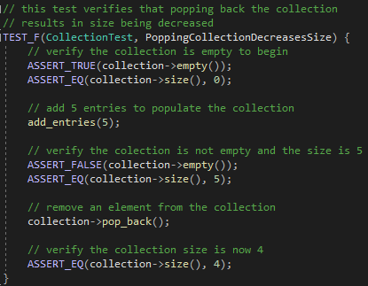
Unit Testing PoppingCollectionDecreasesSize
Notes:
Our next few slides cover some examples of unit tests. Unit testing can be automated so that any new update can be vetted before touching production. The more comprehensive our unit testing is, the less headache we will have later when something goes wrong. The first unit test here simply ensures that popping a collection correctly decreases the size as expected.

Slide 9
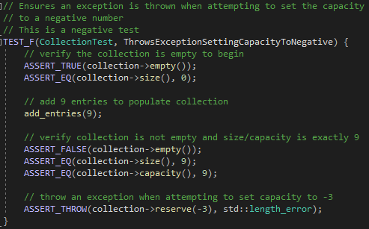
Unit Testing ThrowsExceptionSettingCapacityToNegative
Notes:
We want to include negative testing as well to make sure nothing slips through the cracks, and we get as much coverage as possible. In this example, we attempt to set the capacity of a collection to negative which throws an exception just as we would expect. This can be great for testing exception cases per the coding standards.

Slide 10
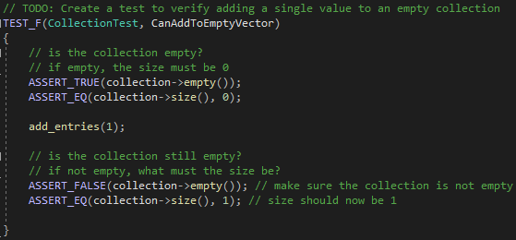
Unit Testing CanAddToEmptyVector
Notes:
The unit tests should be standalone and run independent of one another. They should verify everything works as it is planned to. This test ensures we are able to add to an empty collection. It doesn’t get more basic than this.

Slide 11
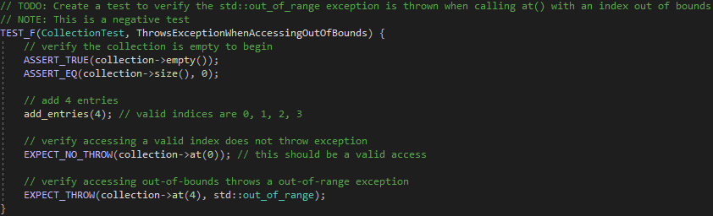
Unit Testing ThrowsExceptionWhenAccessingOutOfBounds
Notes:
One more example of a negative test that verifies accessing an index out of range correctly throws an exception and doesn’t result in a memory access issue.

Slide 12
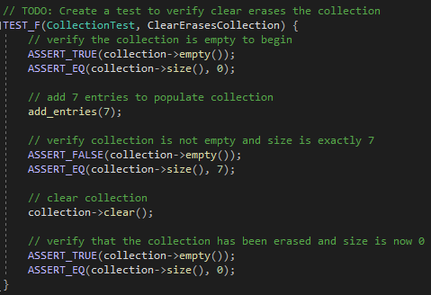
Unit Testing ClearErasesCollection
Notes:
And final example, straightforward and clear in purpose. Verifying a collection correctly clears.

Slide 13

AUTOMATION SUMMARY
Notes:
This graphic shows how automated security checks can be integrated into every phase of the SDLC. Setting up automated trackers to notify teams of new vulnerabilities or regulatory changes with frameworks and libraries they use. Automated static and dynamic runtime analysis and unit testing as we described earlier.

Slide 14
TOOLS
The DevSecOps Pipeline pictured shows how security can be integrated into every stage of the software development lifecycle.
To automate enforcement of the standards defined in this policy, security will be implemented at various stages described below:
Assess & Plan – Automated tracking of threats and regulatory changes
Design & Build – Static code analysis, Unit testing, Threat Modeling, Software composition analysis tools
Verify & Test – Dynamic runtime analysis, penetration testing
Maintain & Stabilize – Use of containerization to increase isolation and secure deployments
Automation Tools⁴:
- CodeSonar v7.3 static analysis -Astrée v23.10 static analysis
- Coverity v2023.6 static analysis -LDRA v9.8.1 static/dynamic analysis, unit testing
- GCC v13.2 compiler -RuleChecker v23.10 static analysis
- PC-lint Plus v2.1 static analysis -SonarQube v9.9.4 static/dynamic analysis
Notes:
What tools can we use to accomplish all this automated testing? There are numerous tools out there such as CodeSonar, RuleChecker, SonarQube and plenty of others.

Slide 15
RISKS AND BENEFITS
Standardization of current security practices will help ensure our team is aligned but comes with some risks to consider. Implementing security throughout the pipeline will incur upfront costs and require some additional time and expertise to get working.
Taking preventative steps to create more robust and secure systems will save money in the long term. Security breaches cost time and money to fix but even worse, they damage customer trust which is extremely difficult to regain.
Example Case:
Progress Software – MOVEit File Transfer
June, 2023
A zero-day vulnerability was exploited impacting over 94 million users, 2500 organizations and costing over $15 billion in damages⁵.
Use of secure coding techniques as outlined by this policy could prevent similar issues through parameterized SQL queries, following The Principle of Least Privilege, and input validation techniques.
Notes:
Why implement this whole security policy and is it more hassle than it is worth? It can be a lot of upfront set up requiring time and expertise, but it will more than make up for it in the long run. It is not a matter of if our system is attacked, but when and how. The MOVEit File Transfer cyber exploit affected 94 million users and cost over $15 billion in damages, not to mention the loss of customer trust. Once you lose trust, it is very difficult to come back.

Slide 16
RECOMMENDATIONS
Potential for Improvements:
Use of third-party auditing such as white-hat security experts can help identify issues through real-world testing.
Some automation tools were listed for security testing, but it would be of further benefit to list all approved/recommended tools, software, libraries that have been vetted for potential vulnerabilities besides just for automation.
Future addition of compliance and regulation requirements that Green Pace is subject to would help further align teams on requirements and standards.
Notes:
There is always room for improvement and this standard should be updated regularly. Some additional opportunities include the use of third-party auditing and security review to identify anything that could be made more secure. We discussed some automated testing tools that could be utilized but a comprehensive list of approved tools, and frameworks to be used could also be of benefit. Additionally, any compliance and regulatory requirements that need to be met could be listed as well.

Slide 17
CONCLUSIONS
Although all standards outlined in this policy are considered important, top consideration should be given to these:
INT-002-CPP Validate data is within expected range
STR-003-CPP Utilize safe String functions to avoid overflows
STR-004-CPP Use prepared statements and parameterized queries to prevent SQL injections
Utilizing a Defense in Depth strategy for layered security with a DevSecOps pipeline ensure security is a central component to Green Pace’s success. To prevent many common vulnerabilities, it is essential to employ encryption techniques and the Triple A framework. Finally, maintaining a constant state of vigilance for potential threats and taking preventative measures can increase security exponentially.
Notes:
There are numerous threats out there that we need to be wary of. Security needs to be part of everything we do. Using a Defense in Depth strategy for layers of security won’t stop all threats but make it exponentially harder for any attackers. By building more secure systems we not only protect ourselves, but our clients as well.

Slide 18
REFERENCES
5. Chin, K. (2024). Biggest Data Breaches in US History. UpGuard. https://www.upguard.com/blog/biggest-data-breaches-us
1. Google Cloud. (2022). Authentication, Integrity, and Encryption. https://cloud.google.com/docs/security/encryption-in-transit
2. JWT. (2024). Introduction to JSON Web Tokens. https://jwt.io/introduction
3. National Institute of Standards and Technology. (n.d.). Least privilege. https://csrc.nist.gov/glossary/term/least_privilege
4. White, B. (2016). SEI CERT C Coding Standard – Analyzers. Carnegie Mellon University. https://wiki.sei.cmu.edu/confluence/display/c/EE.+Analyzers

